Slide 1
3rd PROJECT PRESENTATION GROUP 2
Healthcare Diabetes Dataset Analysis
A Comprehensive Dataset for Diabetes Risk
Elena Tarassenko
Chelsea Sumba
Leor Seal
Michael Roberts
Data Analytics Boot Camp Program
Columbia University School of Engineering
October 24, 2023

Slide 2
Nature of our project
Our group’s chosen topic is the healthcare field of diabetes.
We decided on the field of healthcare because of the abundance of datasets available to us.
The information provided in the dataset can potentially help predict and identify individuals at risk of developing diabetes, lead to early diagnosis and personalized treatment strategies.
We researched the website Kaggle.com and identified the following website/data source:
https://www.kaggle.com/datasets/nanditapore/healthcare-diabetes/
The dataset contains 2,768 records of unique identifiers with 10 columns – further described on the next slide

Slide 3
Definition of Health Attributes in Database
HEALTH ATTRIBUTES (Data Columns) | DEFINITION
Id | Unique identifier for each data entry.
Pregnancies | Number of times pregnant.
Glucose | Plasma glucose concentration over 2 hours in an oral glucose tolerance test.
Blood Pressure | Diastolic blood pressure (mm Hg).
Skin Thickness | Triceps skinfold thickness (mm).
Insulin | 2-Hour serum insulin (mu U/ml).
BMI | Body mass index (weight in kg / height in m^2).
Diabetes Pedigree Function | Diabetes pedigree function, a genetic score of diabetes. (A function which scores likelihood of diabetes based on family history)
Age | Age in years.
Outcome | Binary classification indicating the presence (1) or absence (0) of diabetes.

Slide 4
Strategy for wrangling the dataset
Download dataset from kaggle.com website as csv file
Analyze file for errors and duplications in a variety of ways including Pgadmin,
After analyzing the dataset, we encountered what we thought was duplicate data.
The dataset was cleaned, however, it turned out those duplicates were not duplicates (we reverted back to original dataset). A unique identifier was in the database to ensure all rows were unique
Convert csv file to SQLite database and json file.

Slide 5
Group’s Coding Approach
Use the Flask program within a Python app.py file to connect to database
Use JavaScript within an app.js file to create interactive website dashboard with 5 interconnected and updatable components
Create code for bar charts to display connections between each of the nine 9 health attributes and positive and negative diabetes outcomes – and integrate with interactive website
Create Index.html file to launch interactive website

Slide 6
FLOW OF INTERACTIVE PROJECT WEB PAGE & DASHBOARD
A DROP-DOWN MENU
To select Individual Subject IDs from the data base
A TEST SUBJECT DATA LIST
To display 9 health attributes of each selected ID
A DROP-DOWN BOX
To select 1 specific health attribute of the selected ID
A BAR CHART
To plot selected health attribute with mean score of those who tested positive or negative for diabetes
OUTCOME BOX
Shows Negative or Positive Diabetes Outcome of selected ID

Slide 7
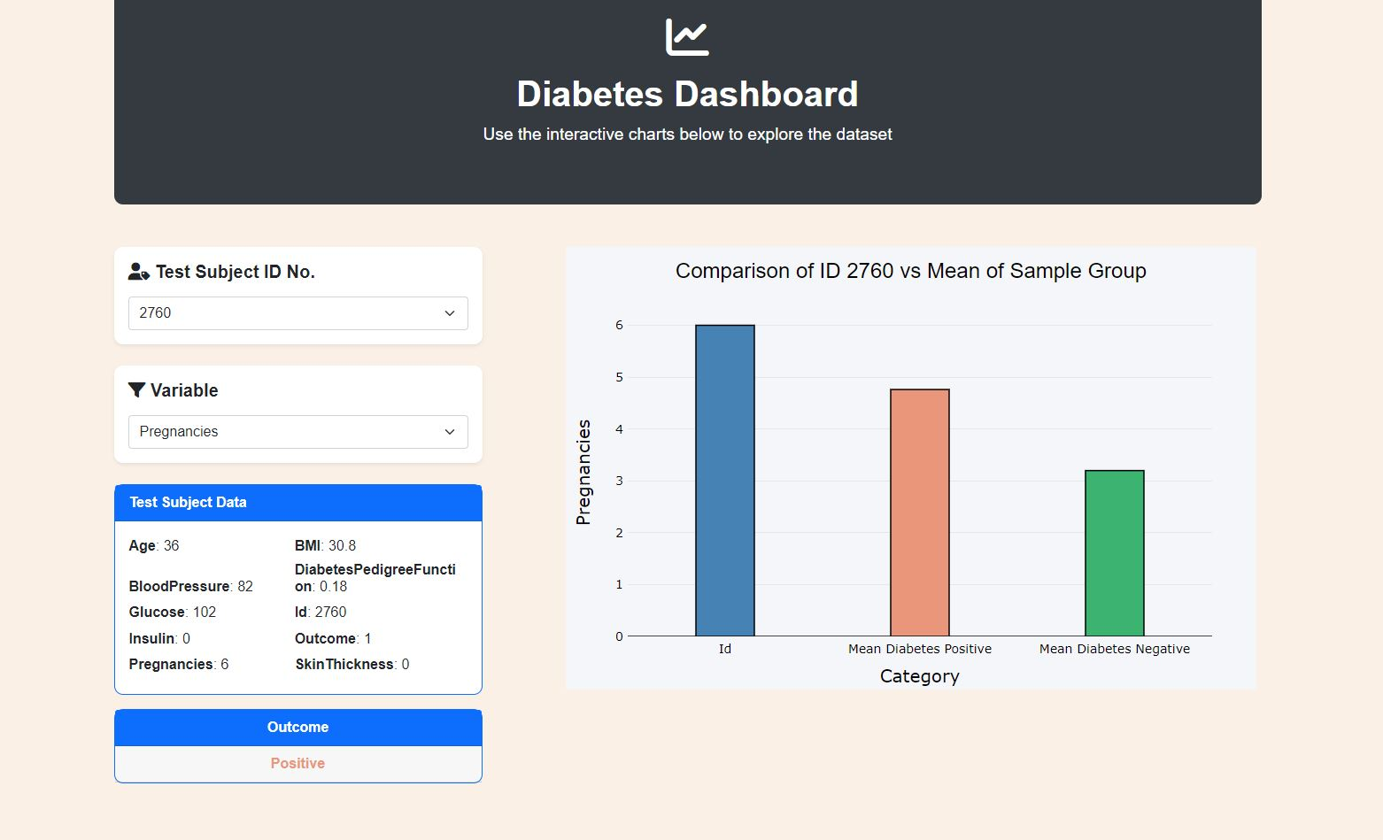
Dashboard Page Example

Slide 8
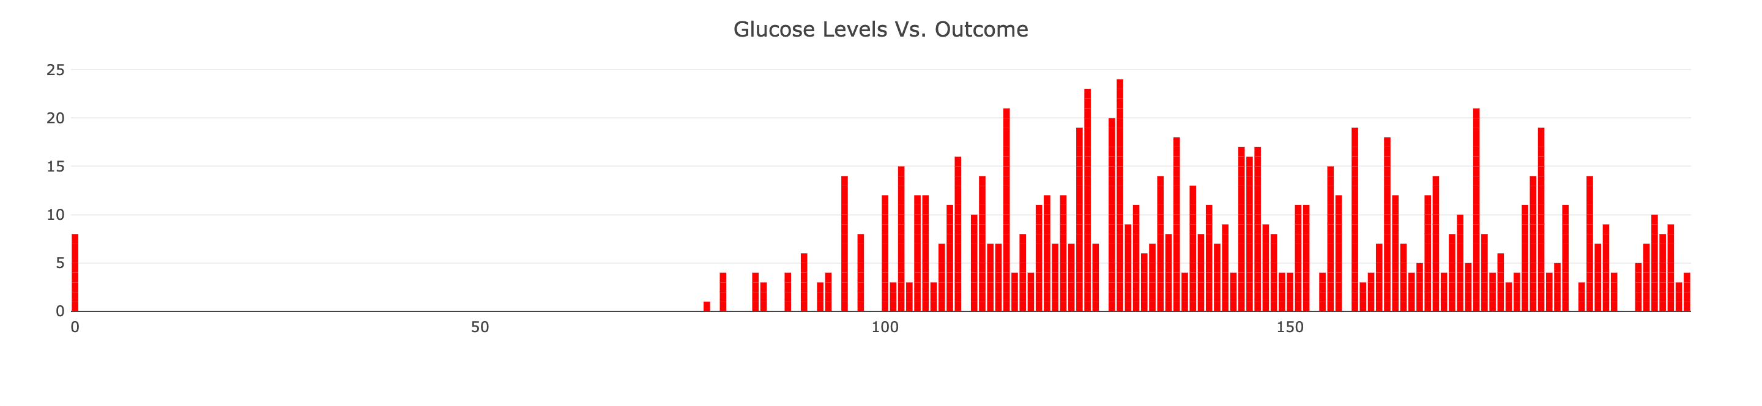
Bar Chart Example – Glucose Levels vs Diabetes Outcome

Slide 9
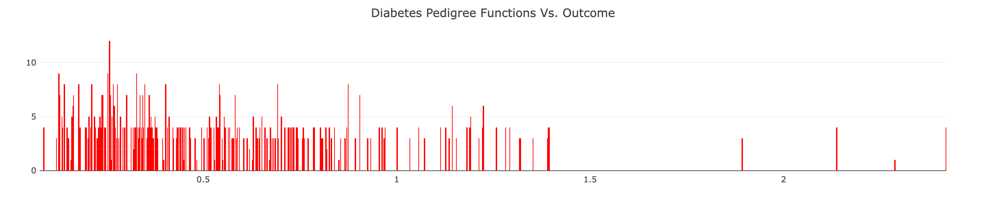
Bar Chart Example Diabetes Pedigree Functions (DPF) vs Diabetes Outcome

Slide 10
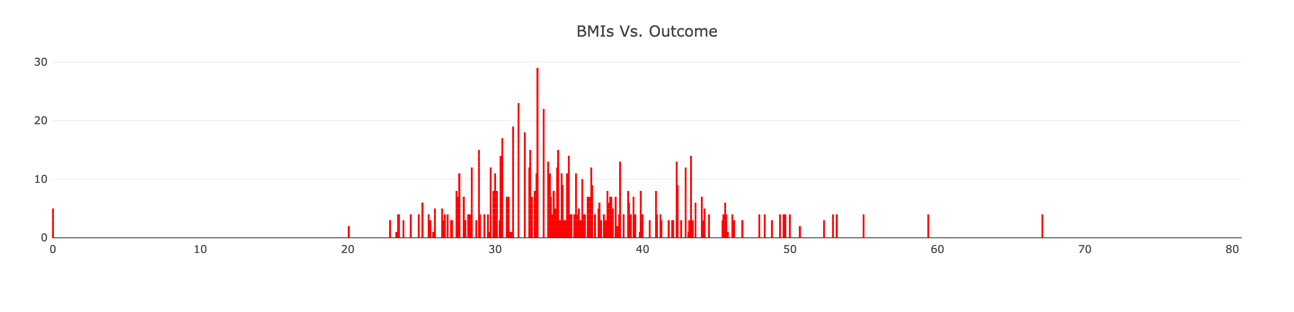
Bar Chart Example – BMI vs Diabetes Outcome

Slide 11
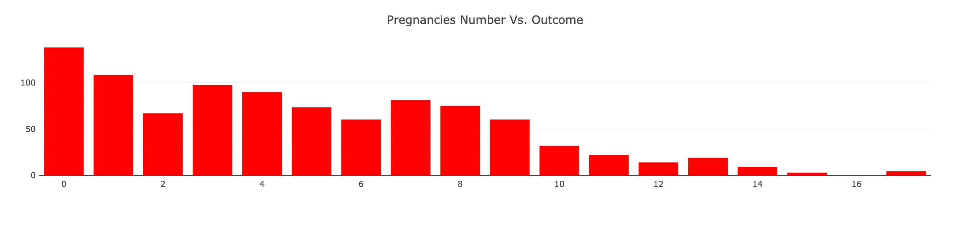
Bar Chart Example – Number of Pregnancies vs Diabetes Outcome

Slide 12
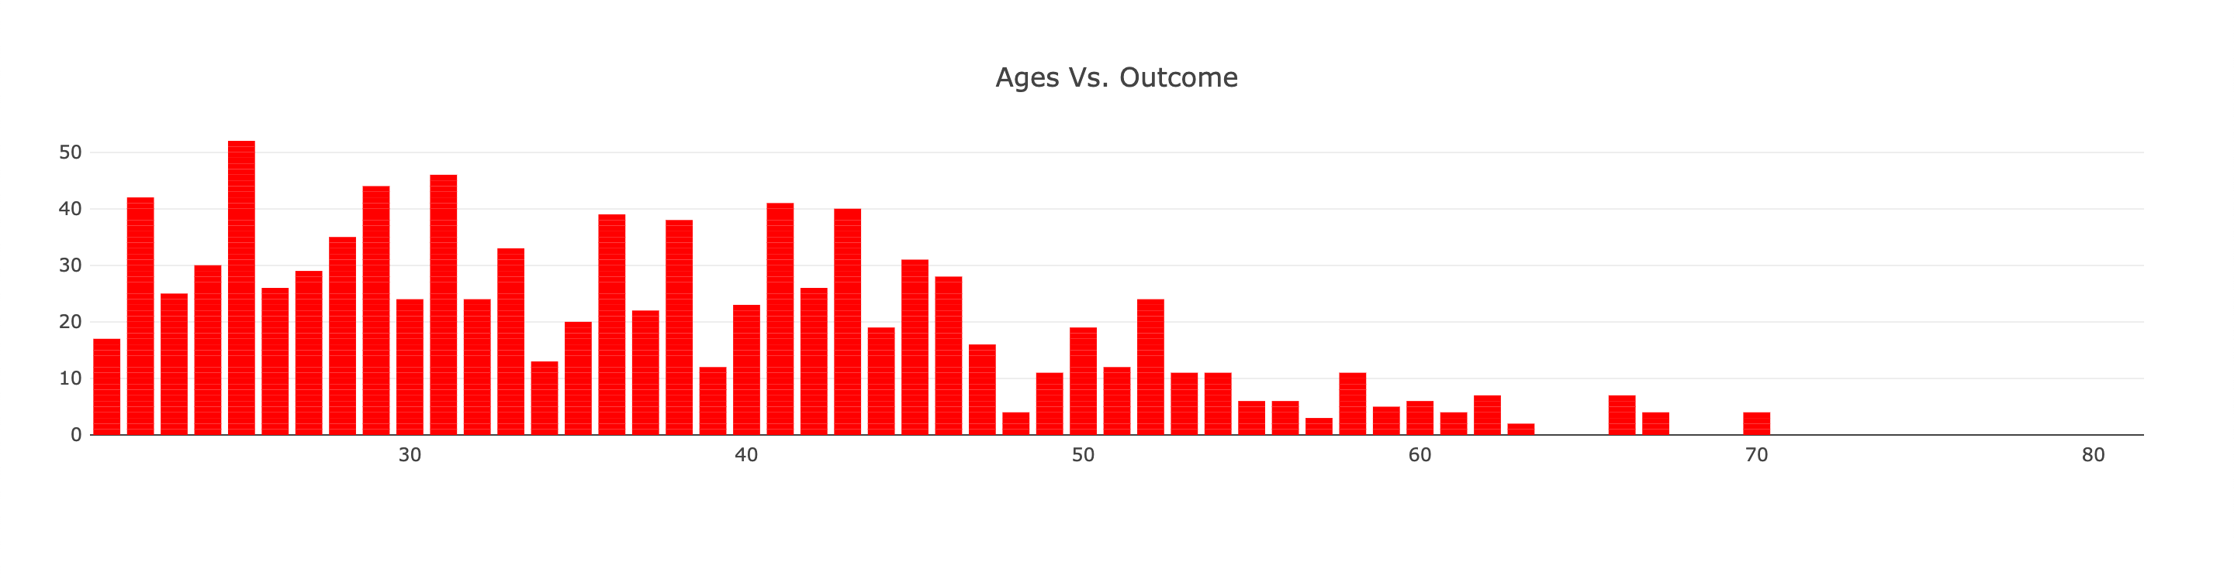
Bar Chart Example – Age vs Diabetes Outcome

Slide 13
Some Key Limitations Of Dataset
The database was missing the following attributes/data columns:
Gender
Race/Ethnicity
Dates
For when each record was entered
When the database was originally created
Major Issue - possible duplication of data – group had to decide whether to use original full dataset (2,768 records) or remove suspected duplicates, leaving 776 records.

Slide 14
Project Data Source
Healthcare Diabetes Dataset
A Comprehensive Dataset for Diabetes Risk Assessment
https://www.kaggle.com/datasets/nanditapore/healthcare-diabetes/

Slide 15
QUESTIONS, DISCUSSION, LESSONS LEARNED
THE END!

